Slide 1
Torque vs Horsepower

Slide 2
Horsepower
The word horsepower was introduced by James Watt, the inventor of the steam engine.
Watt discovered that "a strong horse could lift 150 pounds a height of 220 feet in 1 minute.“
One horsepower is also commonly expressed as 550 pounds one foot in one second:
220 feet in 60 seconds is about 3.6666667 feet traveled per second.
150 pounds * 3.6666667 feet per second is 550 pounds of work per second.
We can see force (pounds), distance (feet), and time, (minute, second).

Slide 3
How to measure torque
Motors spin at a high RPM.
By measuring torque (rotational force generally in pounds at one foot radius) and RPM (time and distance, i.e. distance in circumference at one foot radius) you can calculate horsepower.
You can attach a shaft with a weight on the motor and see much weight the motor can spin.

Slide 4
HP=TORQUE * RPM / 5252
Lets say a 150 pounds is set on a motor with a one foot radius circle. This would be 150 foot pounds torque.
If the motor runs at 220 feet in one minute you need to calculate the RPM.
The circumference of a one foot radius circle is 2 × π × Radius
6.283 feet. ft. (Pi * diameter; 2 * 3.1415 * 1 feet)
The distance the motor runs of 220 feet, divided by the distance of the circle 6.283 feet, is a RPM of 35.015 for the circle.

Slide 5
So we have:
150 foot pounds torque
35 RPM
1 horsepower
150 ft.lbs. * 35.015 RPM / 1hp
5252.25/1hp
1hp=5252
HP=TORQUE * RPM / 5252

Slide 6
Torque is measured in pounds-feet, meaning a force in pounds acting on the end of a lever measured in feet. For example, if that lug wrench is 2 feet long, and you put 100 pounds of force on it, you are putting 200 pounds-feet of torque onto the bolt.

Slide 7
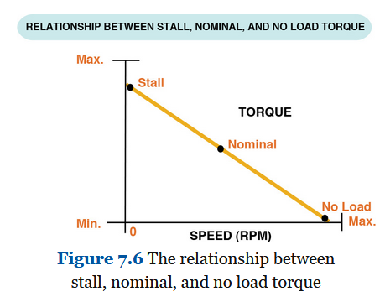
Video Clip

